Slide 1

Art of Machine Learning for Beginners: Azure Machine Learning Automated ML
Milwaukee Tech Hub Summer 2021 Pre-Internship program Azure Machine Learning for Beginners
Balamurugan Balakreshnan – Cloud Solution Architect (Data and AI)

Slide 2
Thank You

Slide 3

Agenda
Agenda: Introduction Azure Machine learning Intro — 1 hour OpenHack use case introduction — 15 mins OpenHack – 4 Hours Take Break when experimentation starts Deploy model — 1 hour Clean up — 15 minutes

Slide 4

Welcome Video

Slide 5












Machine Learning / Predictive Analytics
Machine learning & predictive analytics are core capabilities that are needed throughout your business
Churn analysis
Social network analysis
Recommenda-tion engines
Location-based tracking and services
Vision Analytics
Weather forecasting for business planning
Legal discovery and document archiving
Equipment monitoring
Advertising analysis
Pricing analysis
Fraud detection
Personalized Insurance

Slide 6
Machine Learning Overview
Formal definition: “A computer program is said to learn from experience E with respect to some class of tasks T and performance measure P, if its performance at tasks in T, as measured by P, improves with experience E” - Tom M. Mitchell
Another definition: “The goal of machine learning is to program computers to use example data or past experience to solve a given problem.” – Introduction to Machine Learning, 2nd Edition, MIT Press
ML often involves two primary techniques:
Supervised Learning: Finding the mapping between inputs and outputs using correct values to “train” a model
Unsupervised Learning: Finding patterns in the input data (similar to Density Estimates in Statistics)

Slide 7
Machine Learning
Data:
A B C D E F G H I J K L M N O P Q R S T U V W X Y Z
Rules, or Algorithms:
about, Learning, language – Spelling and sounding builds words
Learning about language. – Words build sentences
Learning, or Abstraction:
Any new understanding proceeds from previous knowledge.

Slide 8
Machine Learning Algorithms
Split into two main categories:
Supervised learning
Predicting the future
Learn from known past examples to predict future
Labels provided
Unsupervised learning
Making sense of data
Understanding the past
Learning the structure of data
Labels no provided
Notes:
Algorithm Documentation: https://msdn.microsoft.com/library/dn905974.aspx
Exploring: https://azuremlsimpleds.azurewebsites.net/simpleds/

Slide 9
Machine Learning Capabilities
Which category
(Classification)
How much/many
(Regression)
Which group
(Clustering,
Recommender)
Is it odd
(Anomaly)
Which action
(Reinforcement Learning)
Notes:
Classification: Assign a category to each item (Chinese | French | Indian | Italian | Japanese restaurant). – Which Category?
Regression: Predict a real value for each item (stock/currency value, temperature). – How much/how many?
Clustering/Recommendation: Partition items into homogeneous groups (clustering twitter posts by topic). – Which Groups?
Anomaly: Identify when something unexpected happens. – Is this weird?
Reinforcement Learning: Make an appropriate action for some new data. – Which action?

Slide 10
Supervised Learning
Used when you want to predict unknown answers from answers you already have – requires data which shows the answers you can get now
Data is divided into two parts: the data you will use to “teach” the system (data set), and the data you will use to see if the computer’s algorithms are accurate (test set)
After you select and clean the data, you select data points that show the right relationships in the data. The answers are “labels”, the categories/columns/attributes are “features” and the values are…values.
Then you select an algorithm to compute the outcome. (Often you choose more than one)
You run the program on the data set, and check to see if you got the right answer from the test set.
Once you perform the experiment, you select the best model. This is the final output – the model is then used against more data to get the answers you need

Slide 11
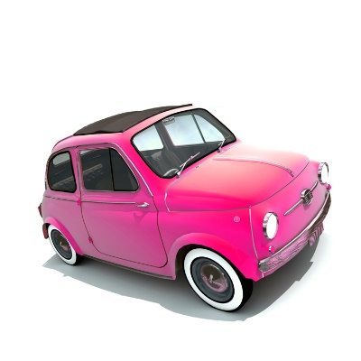
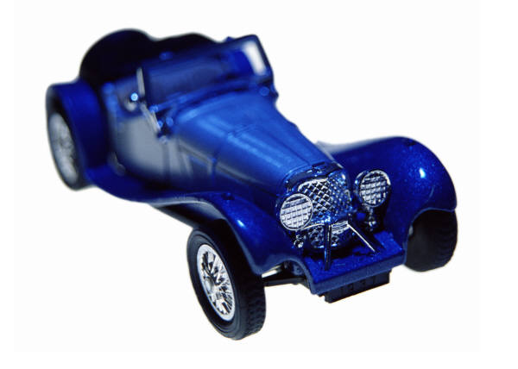
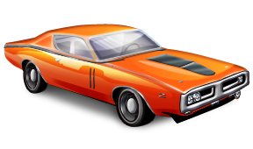
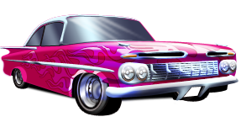
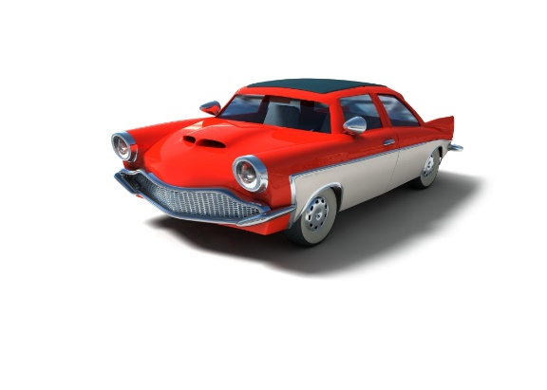

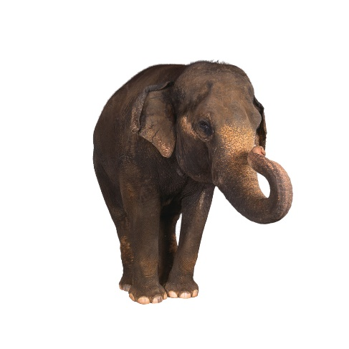
Supervised Learning
Car
Not Car

Slide 12
Unsupervised Learning
Used when you want to find unknown answers – mostly groupings - directly from data
No simple way to evaluate accuracy of what you learn
Evaluates more vectors, groups into sets or classifications
Start with the data
Apply algorithm
Evaluate groups

Slide 13
Unsupervised Learning
Example 1 example A Example 2 example B Example 3 example C
example A | example B | example C
Example 1 | Example 2 | Example 3

Slide 14


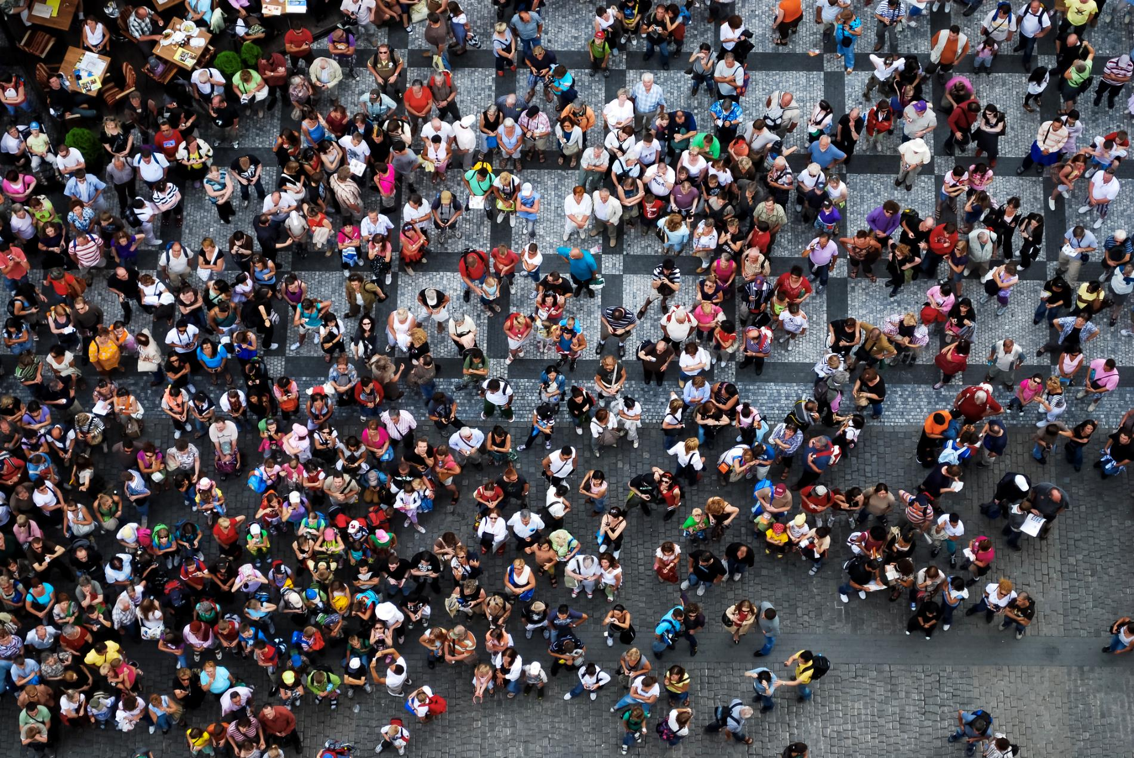
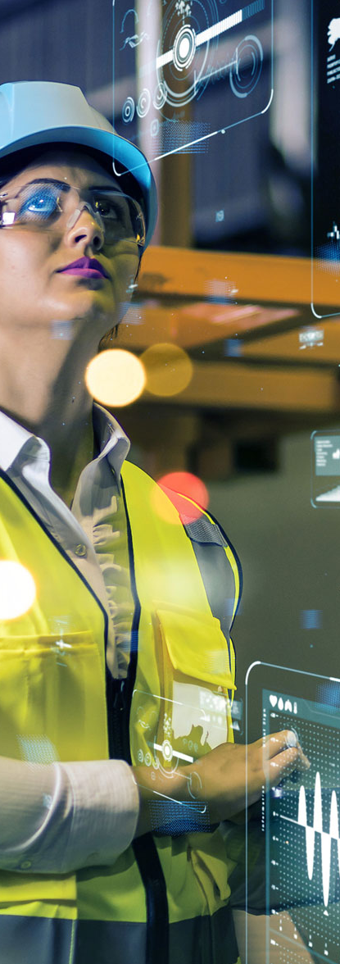

AI challenges
Privacy
Security
Ethics for AI
Workforce
Sustainability

Slide 15
Addressing broader challenges
Privacy
Security
Ethics for AI
Workforce
Sustainability

Slide 16
Azure AI
Azure
Azure AI
Scenario specific services
Bot Service
Cognitive Search
Form Recognizer
Video Indexer
Customizable AI models
Vision, Speech, Language, Decision
Cognitive Services
Machine Learning service
Azure Machine Learning
Data & Analytics
App Development & Tools
Compute
61 Regions
90+ Compliance Offerings
95% Fortune 500 use Azure
$1B Security investment per year
Azure
Notes:
So What is Azure AI?
Azure AI is a set of AI services that are built upon Azure and deeply integrated with Azure’s Data, App Development, Compute services and tools.
With Azure Machine Learning, we provide developers data scientists and developers to build, train and deploy models.
AML is the only cloud ML service that enables developers of all skill levels to build ML models – from a code first experience, to drag & drop, to automated machine learning where developers are not required to have any ML knowledge. No matter how models are built, they are stored and managed in a central registry.
AML also provides advanced MLOPs capabilities with built-in integration with Azure DevOps. This enables developers to achieve model reproducibility, model validation, model deployment and model retraining capabilities.
Finally, AML is built on an open source foundation. Developers can choose the Python tool and process of their choice and even get started on their laptops. They have the freedom to use Mlflow if they’d like and take advantage of the ONNX Runtime to optimize inferencing on multiple HW targets.
Customizable Vision, Speech, Language & Decision Models:
Built with Azure Machine Learning, we also offer developers the most comprehensive set of domain-specific pre-trained models – 30 across Vision, Speech, Language and Decision making – which are all based on our breakthrough research. Not only does Azure AI have the most number of pre-trained models, we are the only ones that can enable deployment anywhere – on-premises, on the edge and even other clouds through the use of containers.
Scenario Specific Services
Finally, we offer AI applications specific services for professional developers.
Azure Bot Service is built on Azure Bot Framework, the most popular open source based bot framework.
This includes Azure Search is the only cloud app search service with built-in AI capabilities. This facilitates the creation of knowledge mining apps.
Form recognizer has been designed to work on specific types of documents – forms. It extracts key value pairs from forms, thereby automating data entry tasks. Form recognizer is used by leading RPA providers as part of their solutions.
Finally, we have Video Indexer. Video Indexer that is used to extract in-depth metadata from video and audio content.

Slide 17
Common AI Patterns
b
a
Machine Learning
AI-powered Apps
Knowledge Mining

Slide 18








What are AI-powered apps?
Users
SERVING LAYER
USER INTERFACE
BUSINESS LOGIC
DATA & SYSTEMS OF RECORD

Slide 19














AI-powered apps
Users
SEARCH
PERSONALIZATION
DOCUMENT PROCESSING
IMAGE & VIDEO ANALYTICS
ANOMALY DETECTION
SPEECH ANALYTICS
SERVING LAYER
USER INTERFACE
BUSINESS LOGIC
DATA & SYSTEMS OF RECORD
TRANSLATION
CONVERSATION
VOICE
BIOMETRICS

Slide 20



Building AI-powered apps
Users
Web and mobile apps
IoT devices
SERVING LAYER
Azure Kubernetes Service
App Service
USER INTERFACE
Bot Service
AI Models
Application code
Cognitive Services
Azure Machine Learning
BUSINESS LOGIC
Pre-built models
Custom models
Cognitive Search
DATA & SYSTEMS OF RECORD

Slide 21
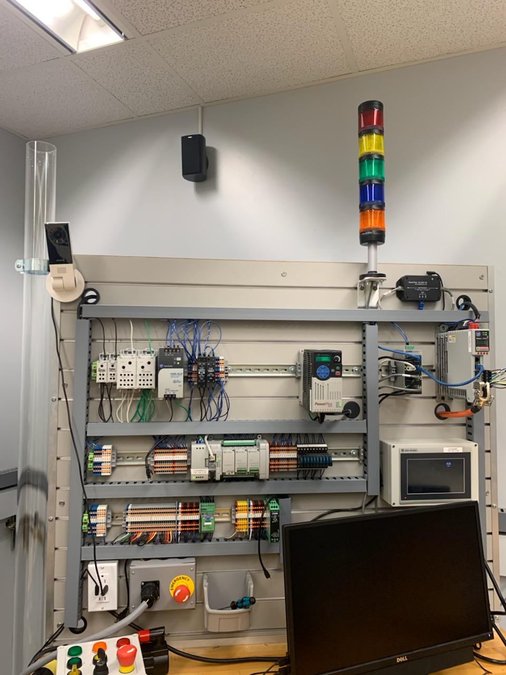
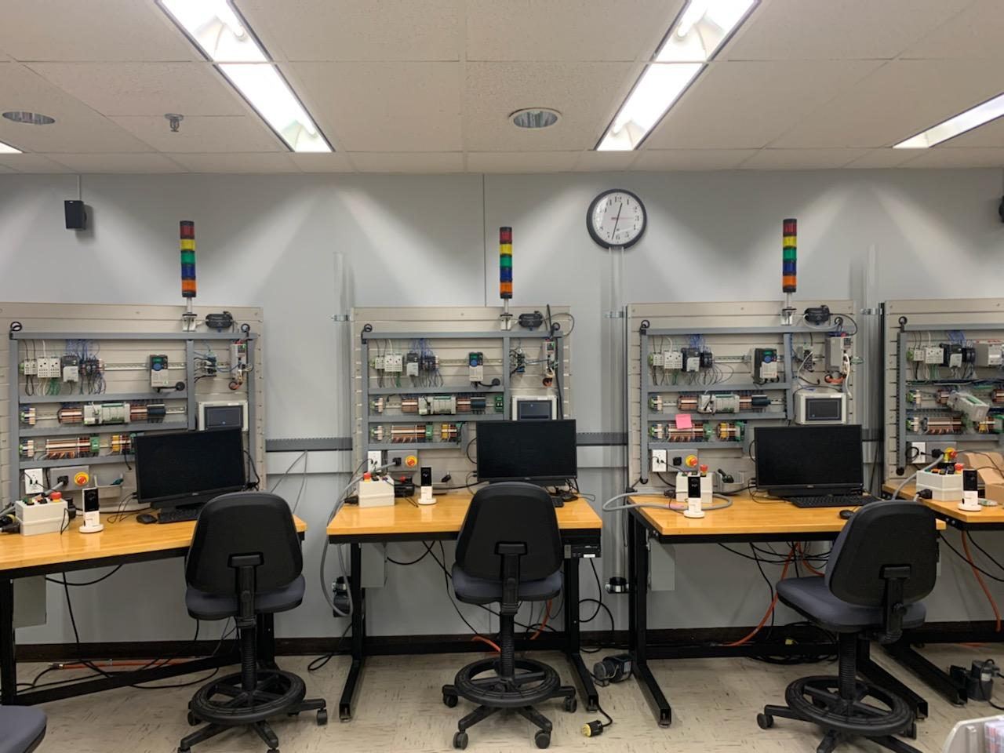
AI in Action: AI for Good – Workplace Safety

Slide 22
Workplace Safety

Slide 23
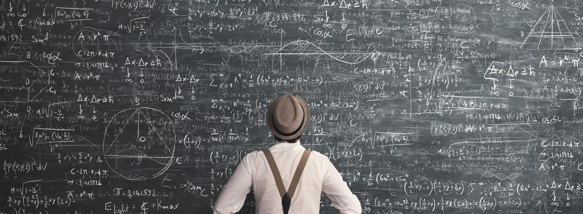
But ML is HARD!
Notes:
7 minutes

Slide 24
Building a model
Notes:
7 – 8 minutes

Slide 25
Building blocks for a Data Science Project
Build and train models
Hyperparameter tuning
Experimentation and pipelines
Deployment
DevOps for data science
Classical ML
Data sources
Deep learning

Slide 26
Data ingestion
Data analysis
Data transformation
Data validation
Data splitting
Trainer
Building a model
Model validation
Training at scale
Roll-out
Serving
Monitoring
Logging
Notes:
8-10 minutes

Slide 27
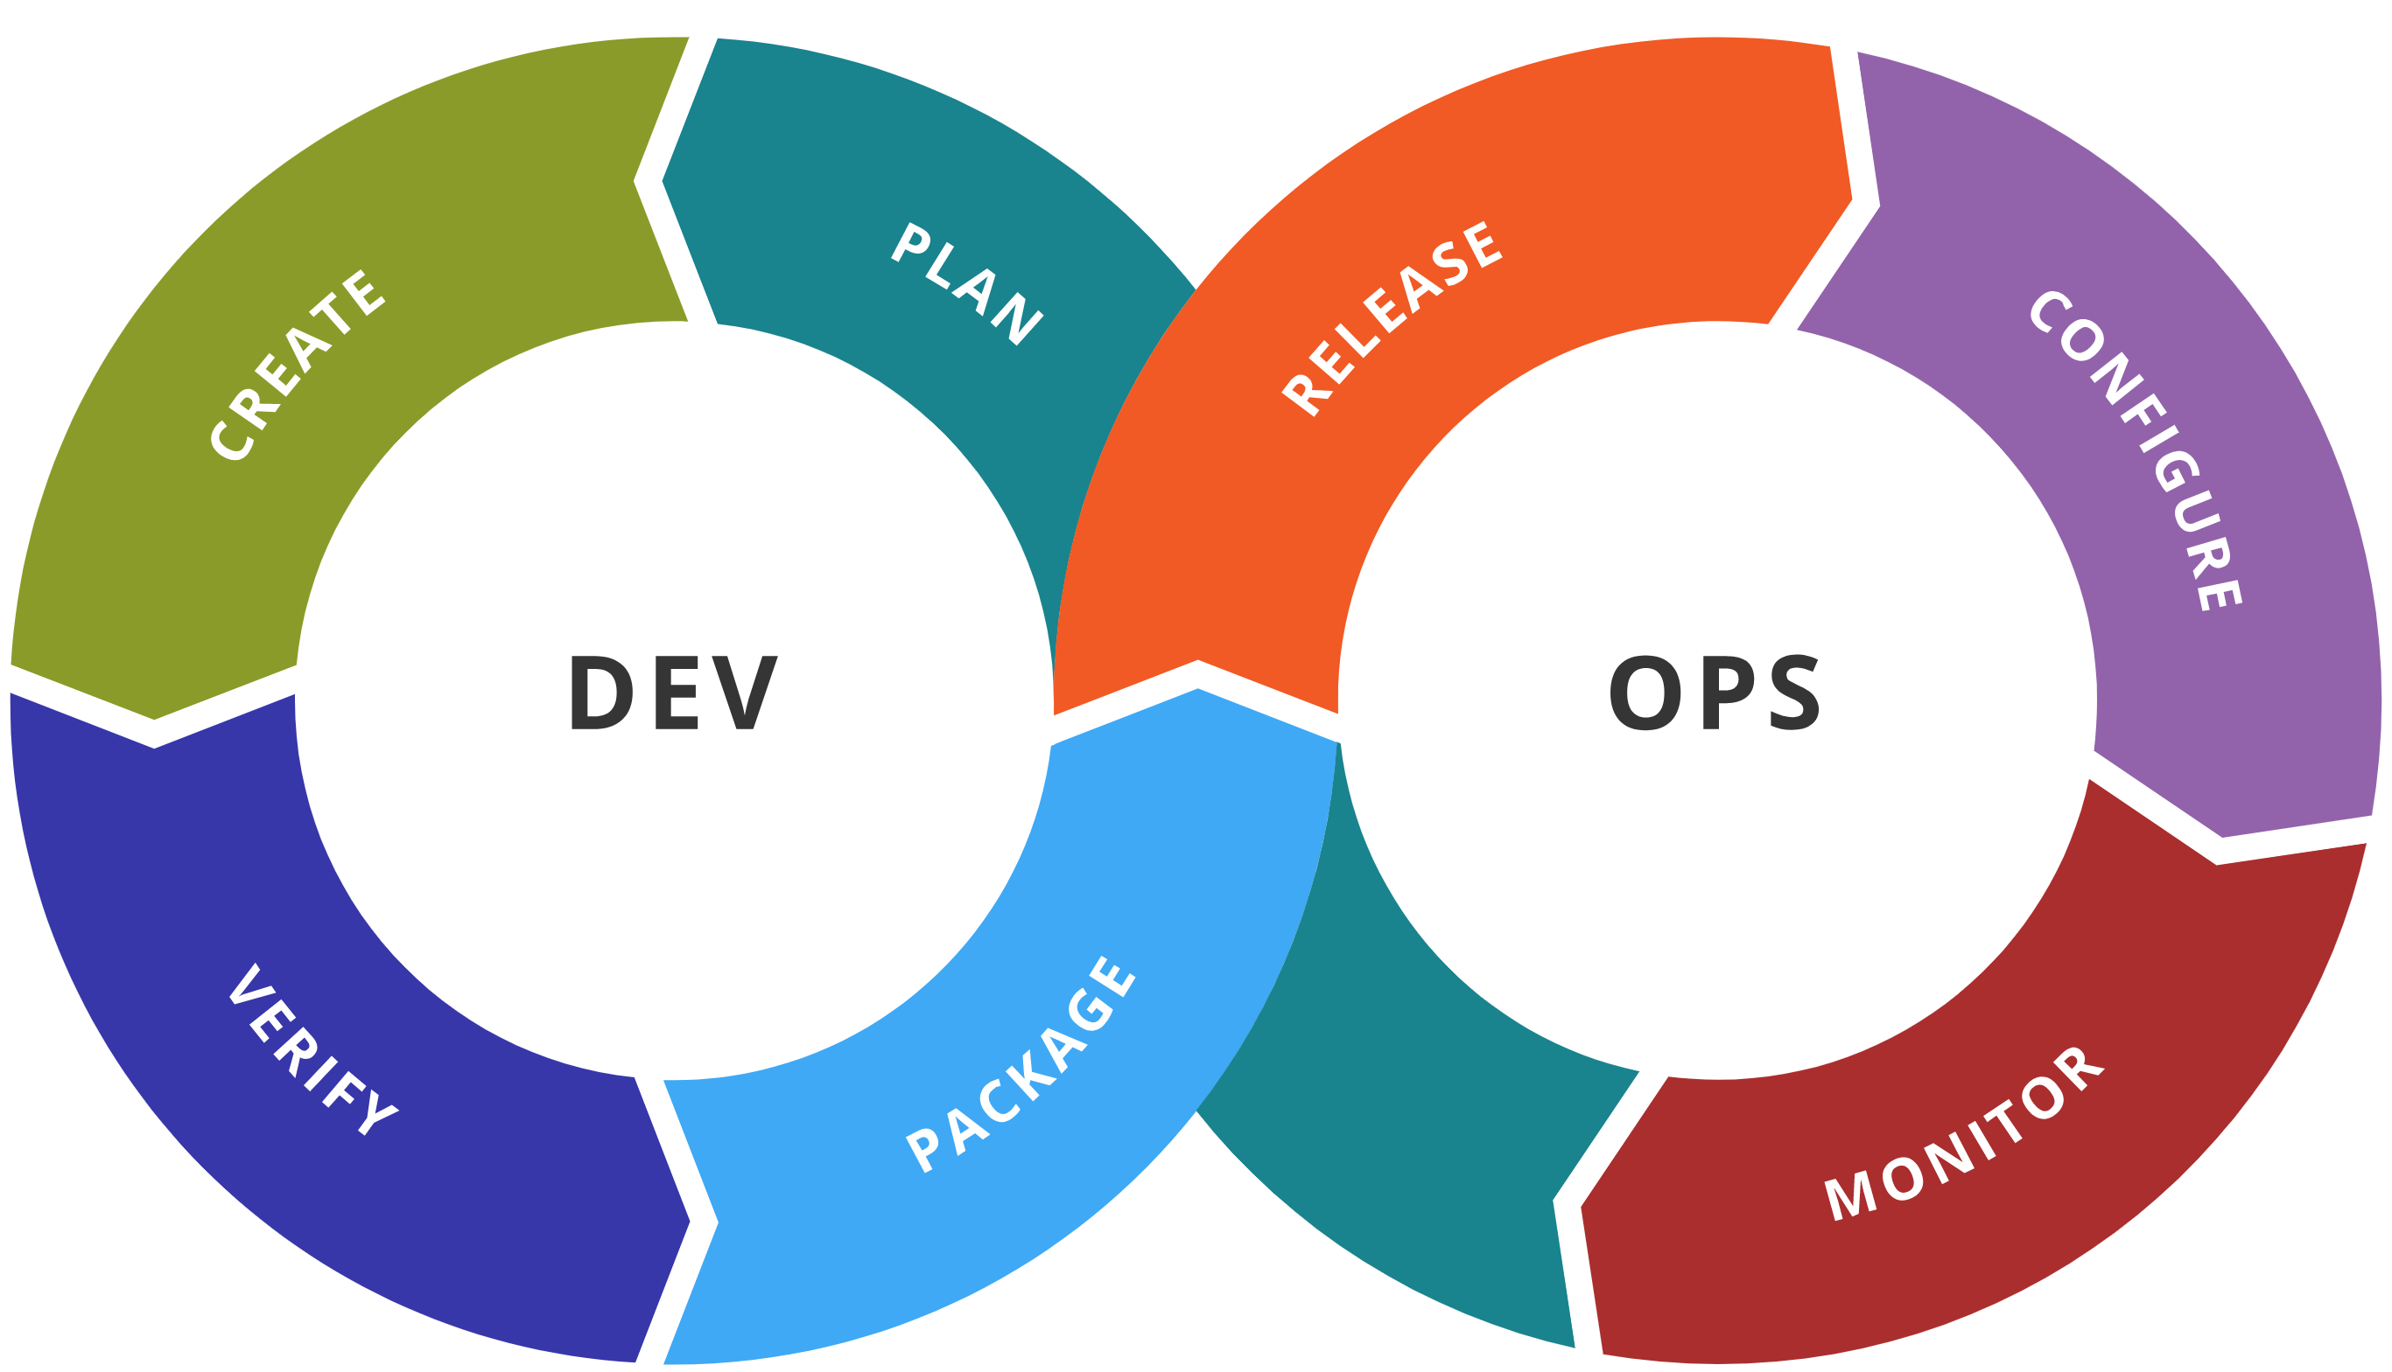
MLOps = ML + DEV + OPS
ML
Experiment
Data Acquisition
Business Understanding
Initial Modeling
Develop
Modeling
Operate
Continuous Delivery
Data Feedback Loop
System + Model Monitoring
+ Testing
Continuous Integration
Continuous Deployment
Notes:
15m-17m

Slide 28






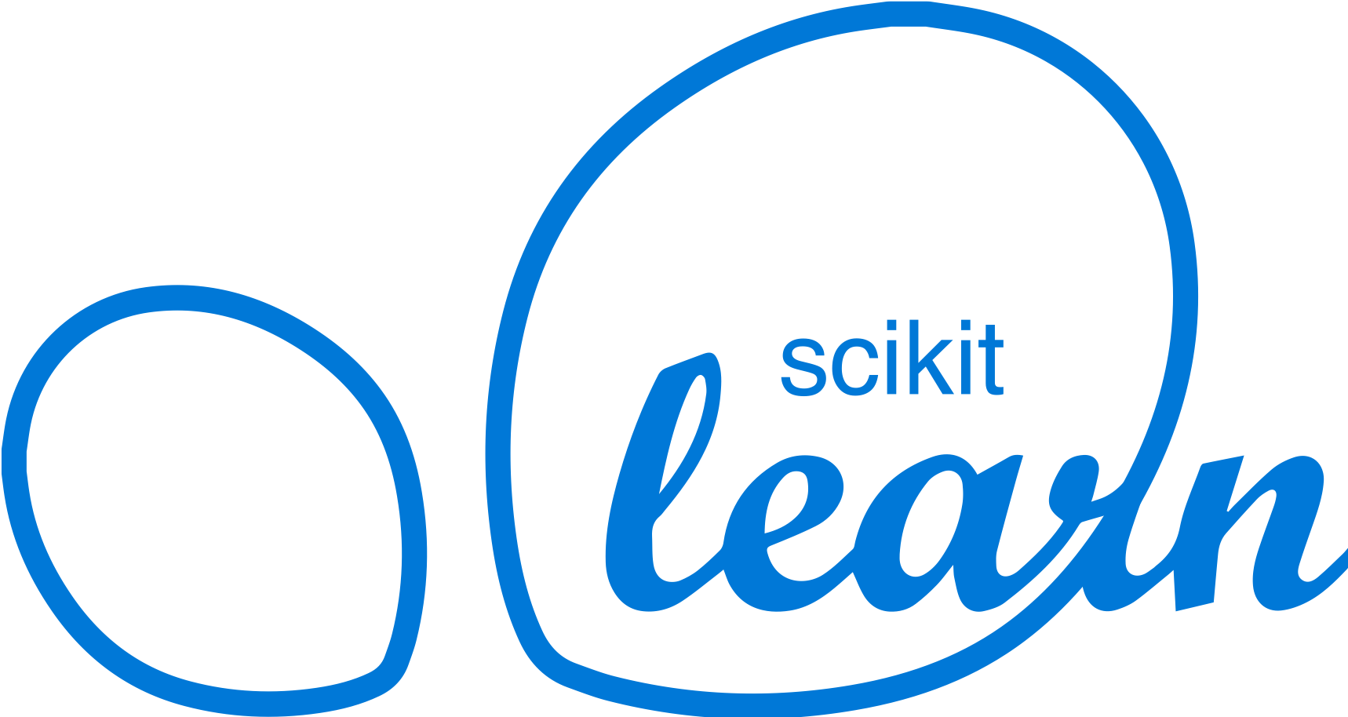

Machine Learning on Azure
Domain Specific Pretrained Models
To reduce time to market
…
Vision
Speech
Language
Search
Familiar Data Science Tools
To simplify model development
PyCharm
Jupyter
Visual Studio Code
Command line
Popular Frameworks
To build machine learning and deep learning solutions
PyTorch
TensorFlow
Scikit-Learn
ONNX
Productive Services
To empower data science and development teams
Azure Databricks
Azure Machine Learning
Azure Machine Learning
Machine Learning VMs
Powerful Hardware
To accelerate deep learning
CPU
GPU
FPGA
From the Intelligent Cloud to the Intelligent Edge
Notes:
Azure has a lot of machine learning abilities, Azure machine learning service is a platform to facilitate the entire machine learning workflow under one roof, while keeping the solution as flexible and customizable as possible.

Slide 29

What is automated machine learning?
Automated machine learning (automated ML) automates feature engineering, algorithm and hyperparameter selection to find the best model for your data.

Slide 30
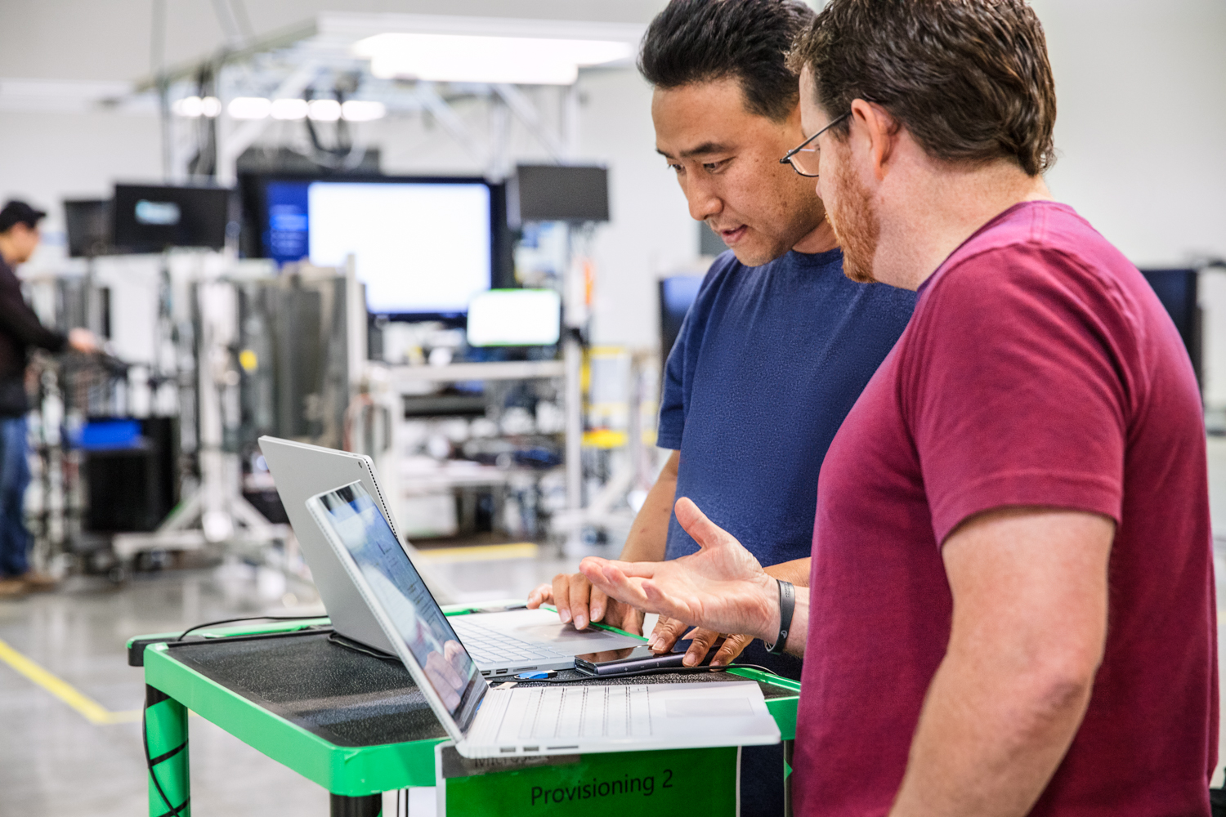


Automated ML Mission
Enable automated building of machine learning with the goal of accelerating, democratizing and scaling AI
Democratize AI
Accelerate AI
Scale AI
Enable Domain Experts & Developers to get rapidly build AI solutions
Improve Productivity for Data Scientists, Citizen Data Scientists, App Developers & Analysts
Build AI solutions at scale in an automated fashion
Notes:
Once you have your data source and format defined. You need to consider how you want the experiment to split your train, test and validation data. Automated ML supports three types.
K-fold
Monte Carlo or repeated random sub-sampling
Manual or custom splits.
K-Fold
For k-fold use n_cross_validations setting to specify the number of cross validations. The training data set will be randomly split into n_cross_validations folds of equal size. During each cross-validation round, one of the folds will be used for validation of the model trained on the remaining folds. This process repeats for n_cross_validations rounds until each fold is used once as validation set. The average scores across all n_cross_validations rounds will be reported, and the corresponding model will be retrained on the whole training data set.
Monte Carlo
Use validation_size to specify the percentage of the training dataset that should be used for validation, and use n_cross_validations to specify the number of cross validations. During each cross validation round, a subset of size validation_size will be randomly selected for validation of the model trained on the remaining data. Finally, the average scores across all n_cross_validations rounds will be reported, and the corresponding model will be retrained on the whole training data set.
Custom Validation Dataset
Use custom validation if random split is not acceptable (usually time series data or imbalanced data). You can specify your own validation dataset. The model will be evaluated against the validation dataset specified instead of random dataset. If you are using custom splits you split you would split your data based on your requirements and pass your training data into the x and y parameters and x_valid and y_valid for validation data.

Slide 31
Machine Learning Problem Example
How much is this car worth?

Slide 32
Model Creation Is Typically Time-Consuming
Which features?
Which algorithm?
Which parameters?
Mileage
Condition
Car brand
Year of make
Regulations
…
Gradient Boosted
Nearest Neighbors
SVM
Bayesian Regression
LGBM
…
Parameter 1
Parameter 2
Parameter 3
Parameter 4
…
Mileage
Gradient Boosted
Criterion
Loss
Min Samples Split
Min Samples Leaf
Others
Car brand
Year of make
30%
Model

Slide 33
Model Creation Is Typically Time-Consuming
Which features?
Which algorithm?
Which parameters?
Mileage
Condition
Car brand
Year of make
Regulations
…
Gradient Boosted
Nearest Neighbors
SVM
Bayesian Regression
LGBM
…
Criterion
Loss
Min Samples Split
Min Samples Leaf
Others
Mileage
Gradient Boosted
N Neighbors
Weights
Metric
P
Others
Condition
Nearest Neighbors
Car brand
Car brand
50%
Year of make
30%
Year of make
Model
Iterate

Slide 34
Model Creation Is Typically Time-Consuming
Which features?
Which algorithm?
Which parameters?
30%
50%
70%
30%
45%
50%
65%
95%
35%
10%
75%
20%
70%
30%
15%
Iterate

Slide 35
Automated ML Accelerates Model Development
Input
Intelligently test multiple models in parallel
Output
25%
Optimized model
25%
40%
Enter data
70%
25%
40%
70%
95%
95%
Define goals
25%
40%
70%
25%
40%
25%
70%
Apply constraints
40%

Slide 36

Automated Machine Learning Under the Hood
User inputs
Feature engineering
Algorithm selection
Hyperparameter tuning
Model Leaderboard
Rank | Model | Score
1 |  | 95%
2 |  | 76%
3 |  | 53%
Dataset
76% | 34% | 82%
41% | 88% | 72%
81% | 54% | 73%
88% | 90% | 91%
95% | 68% | 56%
89% | 89% | 79%
…
Configuration & Constraints
Notes:
This is where Automated machine learning comes handy, and automates that process for us, all you have to do is bring the data, configure a few settings and constraints to the process, like limiting the time you allow it to run, for example, and then Automated machine learning will run and generate many models and rank them based on their accuracy metric, so that you can choose the best performing model. The process is transparent and customizable.

Slide 37
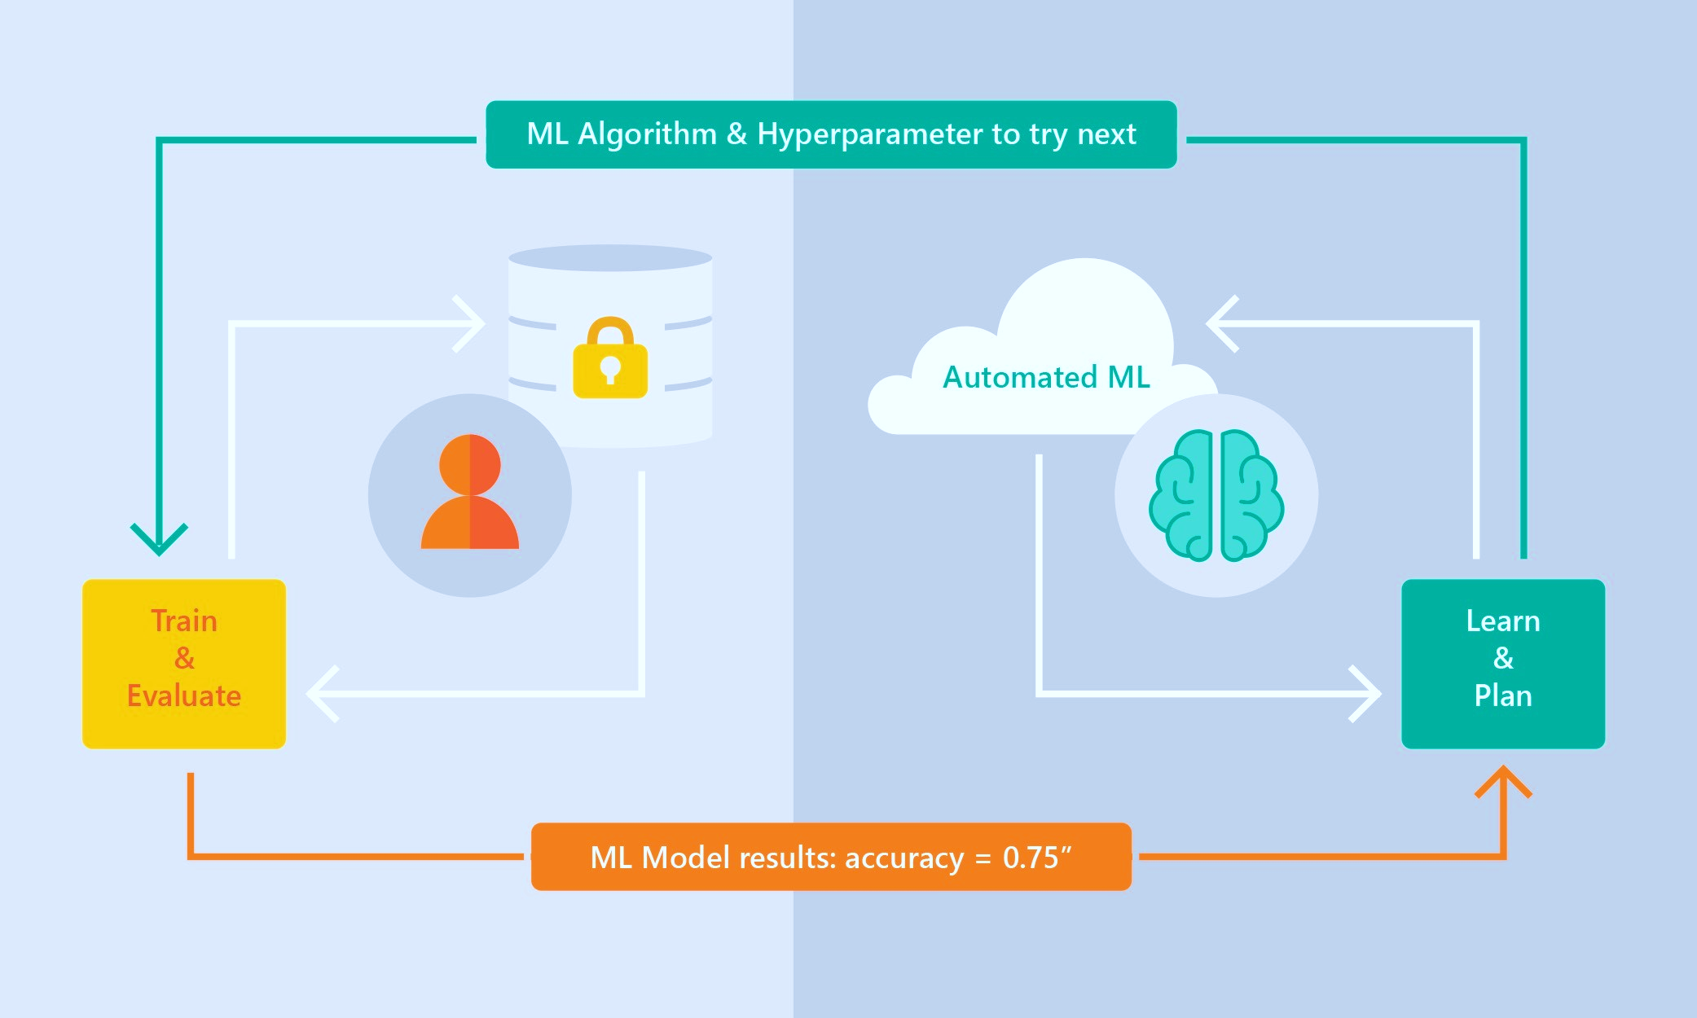



Automated Machine Learning Capabilities
Based on Microsoft Research
Brain trained with several million experiments
Personalized recommendation approach:
Collaborative filtering and Bayesian optimization
Privacy preserving: No need to “see” the data
Supervised Learning
Classification
Regression
Time Series Forecasting
Notes:
What differentiates the solution is the brain of the system, which is based on a research from Microsoft Research. The idea is that a model is trained based on millions of dataset characteristics like size, number and type of columns. and then recommending which algorithm and hyperparameters to use when it sees new datasets. It is a meta-model trained to predict which model to use. I like to think of it as the Netflix of machine learning models – where based on knowledge of previous datasets, the meta-model knows which models to recommend for your data. All this without actually looking at the data itself, so privacy is preserved. The point is, eventually, to help the process converge much faster than just going over all the possibilities randomly. This saves time and money.

Slide 38
Automated ML Capabilities
ML Scenarios: Classification & Regression, Forecasting
Languages: Python SDK for deployment and hosting for inference – Jupyter notebooks
Training Compute: Local Machine, AML Compute, Data Science Virtual Machine (DSVM), Azure Databricks*
Transparency: View run history, model metrics, explainability*
Scale: Faster model training using multiple cores and parallel experiments
* In Preview

Slide 39
Guardrails: Detection and auto-correction of data issues
Class imbalance
Train-Test split, CV, rolling CV
Missing value imputation
Detect high cardinality features
Detect leaky features
Detect overfitting

Slide 40

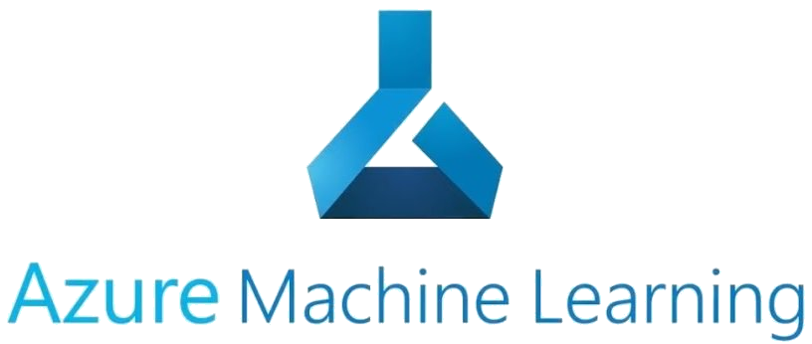







Machine Learning for Everyone
Automated Machine Learning
Data Scientist
Data Engineer
Developer
Data Analyst
Citizen Data Scientist
Notes:
So how do you get started? Automated machine learning is for everyone who is working with data. If you are a data scientist, you will be comfortable using the Python SDK in Jupyter notebook, and you’ll be able to use Jupyter notebooks from the Azure machine learning service. If you are a citizen data scientist, or if you just started making your way as a data scientist, or if you prefer graphical user interface over coding, you can use the Automated machine learning web user interface in Azure machine learning service, and start a training job within just a few clicks of a button. If you are a data analyst, business analyst, or data engineer, you can use the integrations with Power BI, Alteryx, and SQL Server, to train and predict directly from the tools that you are already using on a daily basis. If you are a developer, you can use Automated machine learning in Visual Studio with the ML.NET library, or you can code directly with Python.

Slide 41









Customer Testimonials
With one line of code, it runs through different algorithms within the prediction family and the different parameter (or variable) combos that previously were manually tested by the scientists. The power of the cloud comes in here. The results are comparable to what the data scientists produced.
Manish Naik, BP, Digital Innovation
The reason we see the sharp uplift in sales is the customers are getting content that really connects with them, and they're getting offers for things that are truly relevant and relevant at that moment in time…. Microsoft—they are really wanting to be our partners and were really going to help us on this journey, which was very differentiating
Daniel Humble, Chief Data and Analytics Officer, Walgreens Boots Alliance
If I have 200 models to train—I can just do this all at once. It can be farmed out to a huge computer cluster, and it can be done in minutes so I'm not waiting for days or setting experiments to run over the weekend anymore.
Dean Riddlesden, Senior Data Scientist, Walgreens Boots Alliance
Auto ML’s execution of different models was an impressive that enabled data scientists to work iteratively on machine learning experiments to increase auction sales by 10% and optimize the time auction cars are kept in the showroom to less than 30 days.
Farika Maharani, PT. Serasi Autoraya, Data Platform Supervisor
The CBRE AI and Data Engineering Team have successfully deployed a complete Azure Machine Learning model to their new API gateway leveraging the Azure AutoML solution in Azure Databricks. The API Gateway plus the model deployment goes into production this March.
Francis Dogbey, Microsoft CSA
We tried AutoML for aspect ratio model and pleased to see AutoML produced much better model than our baseline. We need to build almost 50 models and are looking forward to the productivity boost we will get by not hand tuning each one of them!
Saurabh Naik, Sr. Software Engineer
In evaluating Azure Automated ML we discovered real potential in shortening the time to market for producing predictive models. The availability of the Automated ML UI also holds the promise of opening the ML space to non data science trained resources which in turn allows the democratizing of the predictive work without the pain of hiring expensive/ hard to retain staff.
Bogdan Rosca, Senior Director, Principal Information Architect
Teams uses machine learning to analyze, gain insights and improve the quality of calls. We use AutoML to significantly scale up the application of ML solutions by semi-automating model train tasks
We see advantages moving over to Azure AutoML because we think we will be able to increase our speed to create models significantly and do more with less in terms of labor hours.
Dan Metzendorf, Data Science Manager, The Sherwin Williams Company
AutoML resulted in a significant improvement in model performance (1) Consistently produced better models than other automated ml libraries (TPOT) (2) Also outperformed hand-tuned models. AutoML explored a solution space larger than what was plausible to do manually
David Robinson, Devon Energy Data Scientist

Slide 42
What’s new?

Slide 43
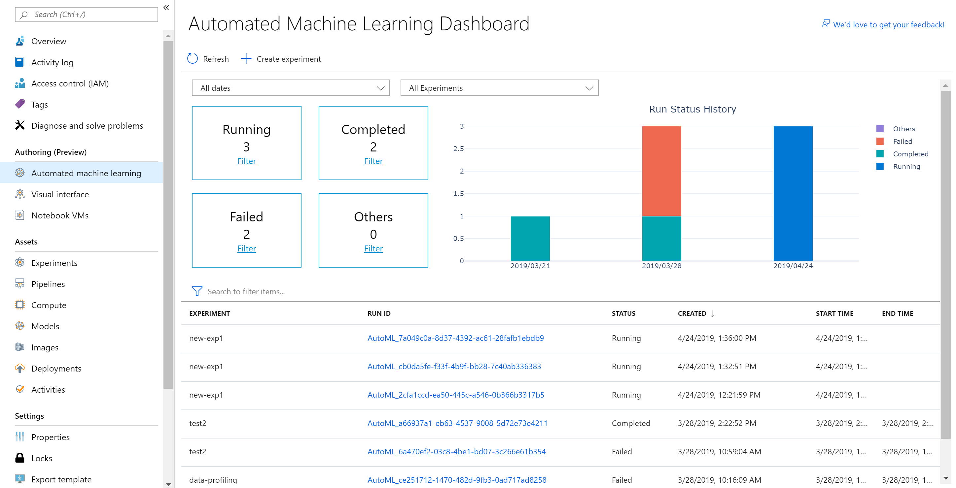
Latest announcements (Blog post with all the announcements)
Automated ML Updates
Link
Managed Endpoint

Slide 44

Workshop
Prerequisites
1. Azure Subscription
2. Azure ML workspace

Slide 45
1. Go to Medium location: OpenHack 2. Git hub link Agenda: Introduction Azure Machine learning Intro — 1 hour OpenHack use case introduction — 15 mins OpenHack – 4 Hours Take Break when experimentation starts Deploy model — 1 hour Clean up — 15 minutes Note: When experiment is submitted will take a long time to run since automated machine learning runs about 50 or more algorithm to provide us results. Deploying to REST API as ACI or AKS will also take about 15 to 30 minutes. Some time delete and recreate will be needed but as the instructor for details
Workshop Lab Instructions

Slide 46


Resources http://aka.ms/amlfree
Learn more : https://aka.ms/automatedmldocs
Notebook Samples : https://aka.ms/automatedmlsamples
Blog Post : https://aka.ms/AutomatedML
Product Feedback : AskAutomatedML@microsoft.com
Workplace Safety: https://github.com/balakreshnan/WorkplaceSafety
Covid 19 Social Distancing:
sdd/covidproject.md at master · balakreshnan/sdd (github.com)
AI and Big Data:
AzurePercept/synapseint.md at main · balakreshnan/AzurePercept (github.com)
Notes:
Choose between visual drag-and-drop or code-first authoring with complete control
Use your favorite IDE, built into your favorite IDE (VS Code only @ Public Preview)
Use any framework or library and the most popular languages
Faster, easier training on industry leading Spark

Slide 47
Resources
PPE Compliance Detection using Artificial Intelligence in Learning Factories
A Collaboratively Developed Platform to Introduce Fundamentals of IoT and IIoT
Notes:
Choose between visual drag-and-drop or code-first authoring with complete control
Use your favorite IDE, built into your favorite IDE (VS Code only @ Public Preview)
Use any framework or library and the most popular languages
Faster, easier training on industry leading Spark

Slide 48
Thank You

